Slide 1
Scientific Calculator Project
Python • Tkinter • GUI Application

Slide 2
Developer Information
Name: Yogesh Kumar
Organization: NextHikes IT Solutions
Department: Data Science & Artificial Intelligence

Slide 3
Introduction
This project is a fully functional GUI-based Scientific Calculator.
It supports both Standard and Scientific modes with advanced mathematical features.
Developed using Python Tkinter library.
Supports Standard and Scientific modes.

Slide 4
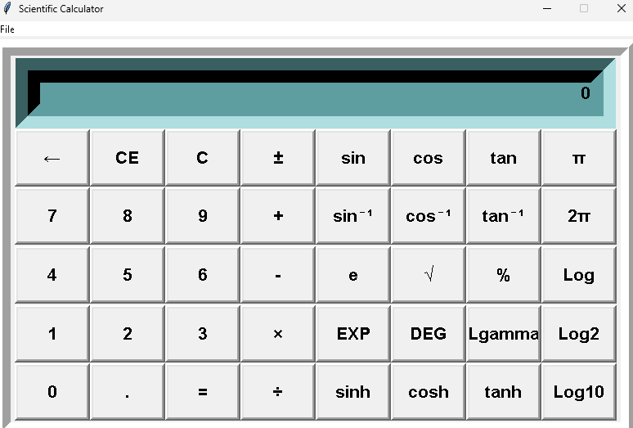
Application Output

Slide 5
Key Features
User-friendly GUI
Standard arithmetic operations
Scientific functions (sin, cos, tan, log, sqrt, pi, tau)
Error handling & clean UI
Error handling (division by zero)

Slide 6
Code Structure (Part 1)
Import libraries: Tkinter, Math
Initialize main window
Create frames for layout
Setup display entry box
Define main Frame and Calculator Frame

Slide 7
Code Structure (Part 2)
Calc Class handles all mathematics
Tracks: total, current, operator, input status
Functions for add, subtract, multiply, divide
Handles exceptions like divide by zero

Slide 8
Scientific Functions
Trigonometric: sin, cos, tan
Inverse Trigonometric: asin, acos, atan
Logarithmic: log, log2, log10
Constants: pi, tau, e
Hyperbolic: sinh, cosh, tanh

Slide 9
Working Mechanism
User clicks a button
Input processed through Calc class
Operation verified and executed
Result displayed in output screen

Slide 10
Advantages
Easy-to-use interface
Covers scientific and standard functionalities
Built with Python, highly customizable
Lightweight application
Start → Button Press → Check Input Type →
Process Number / Operation → Update Display → Show Output → End

Slide 11
Conclusion
This Scientific Calculator demonstrates GUI development in Python.
It combines OOP, Tkinter, and math functions into one powerful tool.

